Slide 1
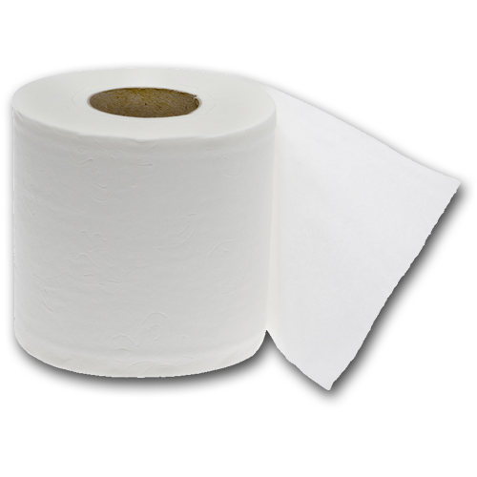
Grab the TP Final
Linda Puzey
Spider-Man Work from Home

Slide 2
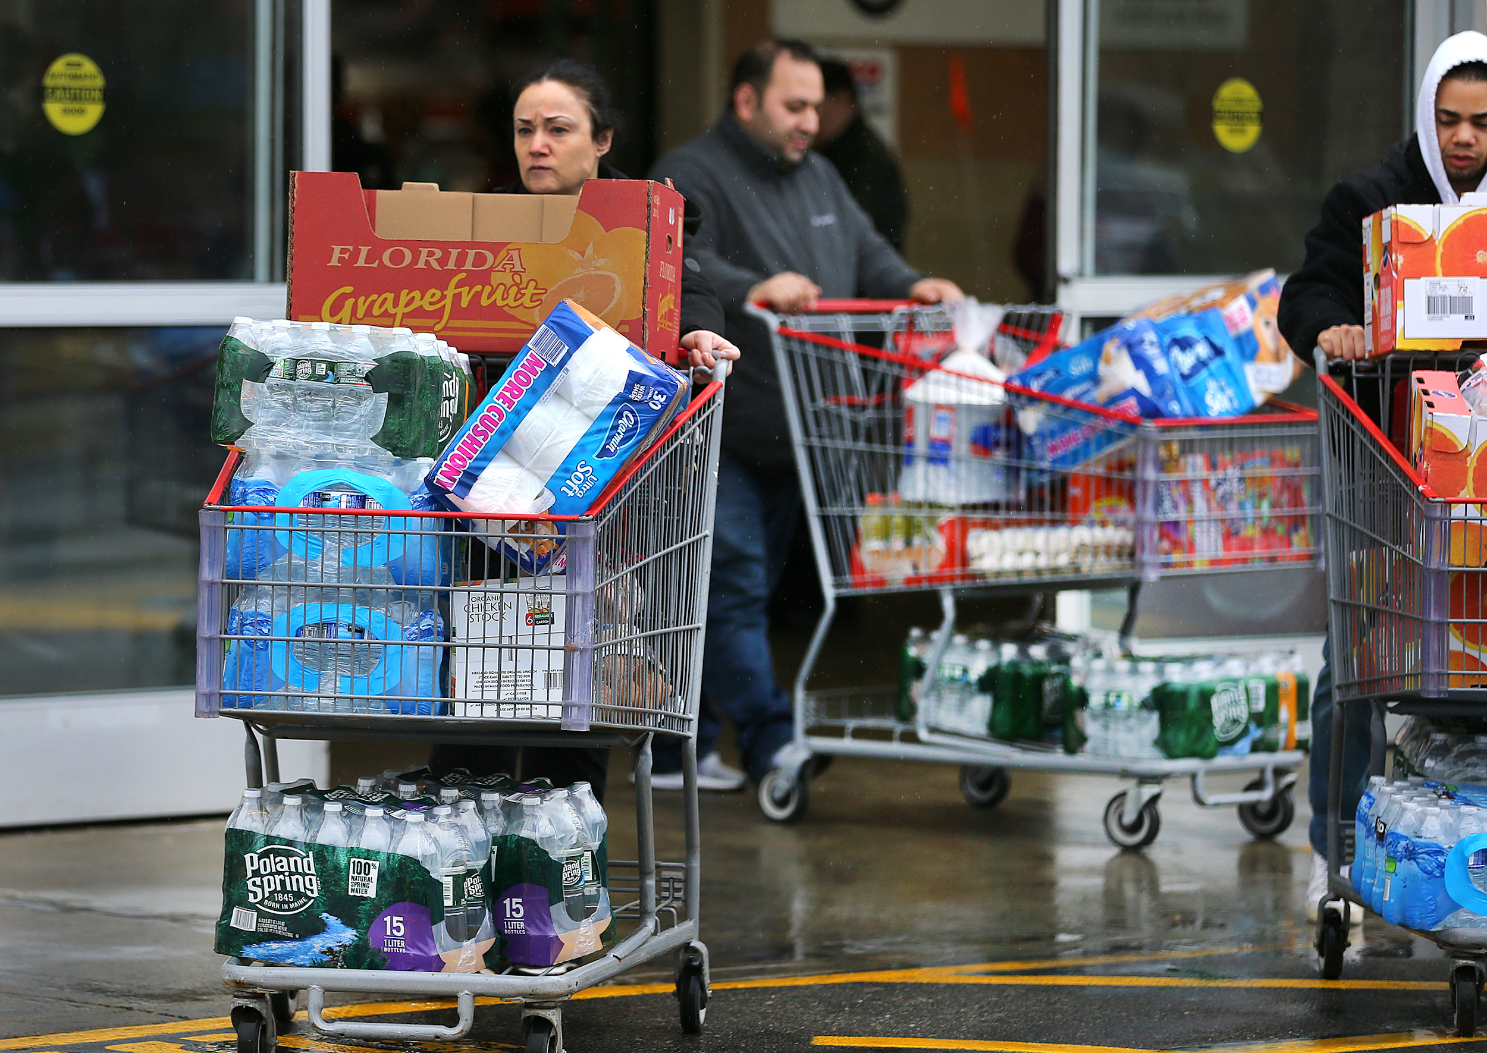
Logline
Corona has hit! Hoard all the toilet paper you can before it’s too late!

Slide 3
Features List
6 levels
Levels get progressively harder
Toilet Paper that appears randomly and falls
Don’t grab anything infected with Corona or you lose a life
3 Lives before you get corona and die

Slide 4
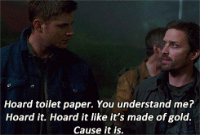
Artist Statement
The experience goal of this game is to poke fun at the absurdity of people hoarding toilet paper during the coronavirus pandemic. It is meant to be fun in the hopes that some people can get a chuckle out of it during this crazy time. It is also supposed to be addictive so that people keep coming back to get to a higher level.

Slide 5
Play Description
Toilet paper will be falling from the top of the screen to the bottom. Player will control a shopping cart at the bottom row that will catch up to four toilet paper rolls. The player must empty their toilet paper into the car before the cart gets too full. If the cart gets too full the player will lose one of three lives. The player will need to fill the car with a certain amount of toilet paper to progress to the next level. The levels will get progressively harder as the player gets further along. Eventually things (coronavirus) will begin to fall that the player should not get in their cart. If they get a bad item in their cart, they will lose a life. If they lose all of their lives, the game is over.

Slide 6
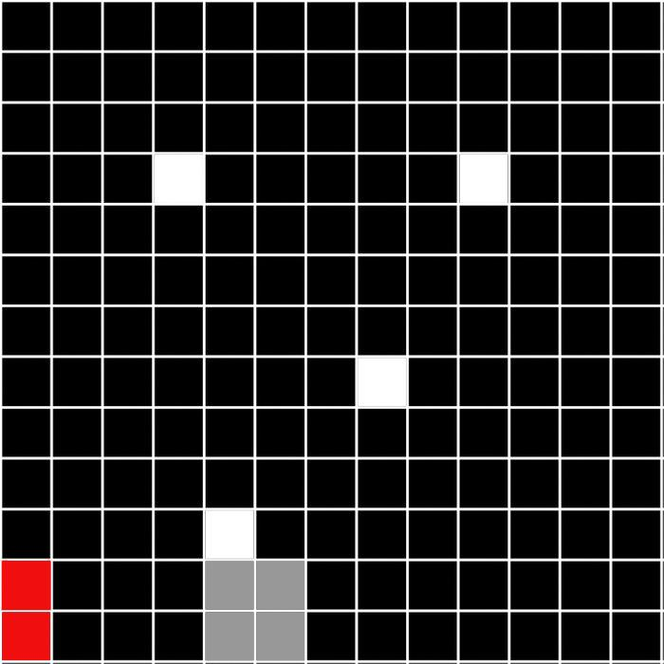
OrignalGame Board Mockup
White is the falling toilet paper
Grey block is the shopping cart
Allow the toilet paper to fall into the shopping cart
Move shopping cart left and right by sliding mouse
Shopping cart can only hold 4 toilet papers at once
Click next to the red blox (car) to empty out of cart

Slide 7
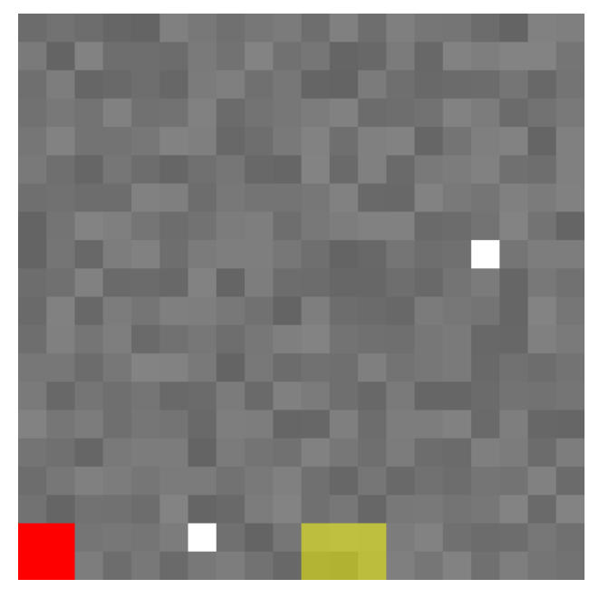
Prototype 1 Mockup
Toilet paper is falling and you can catch it
It can also be emptied into the cart if you are next to it
The color of the cart changes to depict how many TP you have in it
TP shows up on the top of the car when emptied

Slide 8
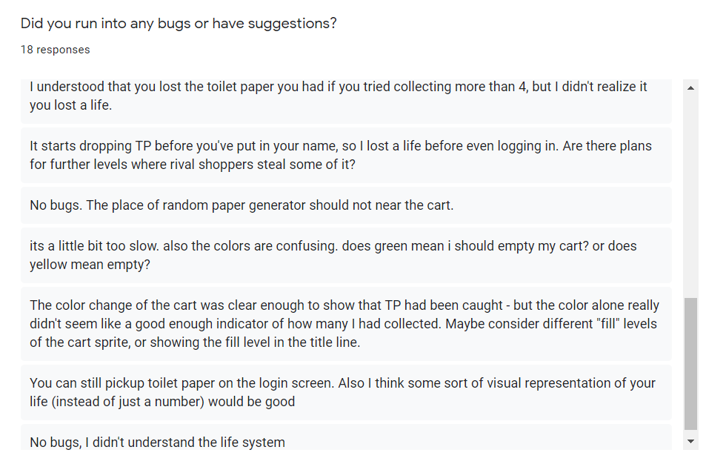
Prototype 1 Survey Responses
The main thing people complained about was how color changing of the shopping cart
Did not indicate how many TP was in cart very well
People did not understand the life system
People did not like the background

Slide 9
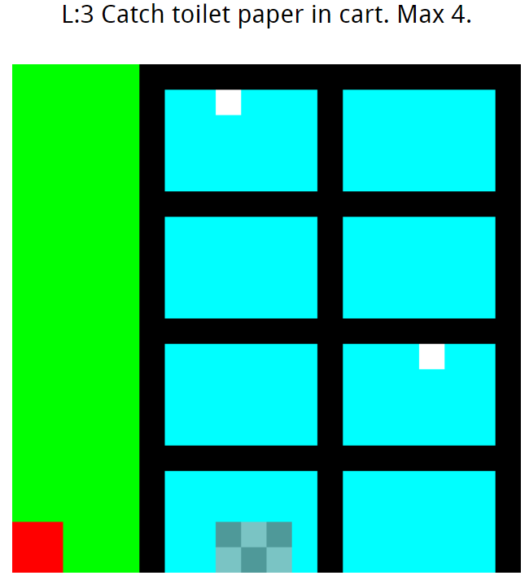
Prototype 2 Mockup
The most important change was the cart to show how many TP was inside of it
Also changed the background to look prettier

Slide 10
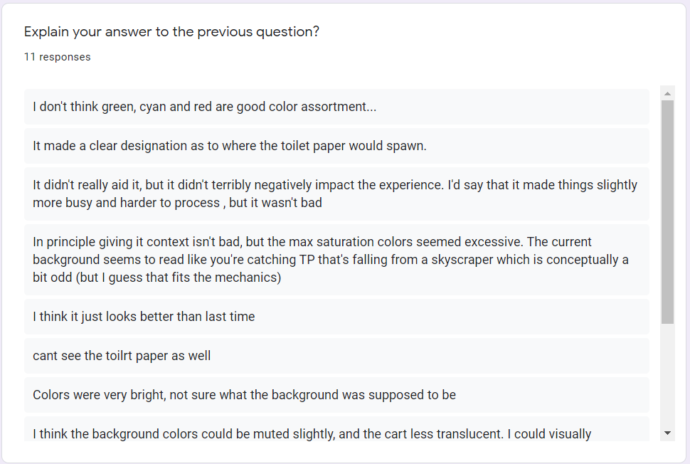
Prototype 2 Survey Responses
People did not like how saturated the background was this time around
People also suggest an easy way to indicate the amount of lives you have
They also wanted some obstacles to avoid
In addition they wanted level progression

Slide 11
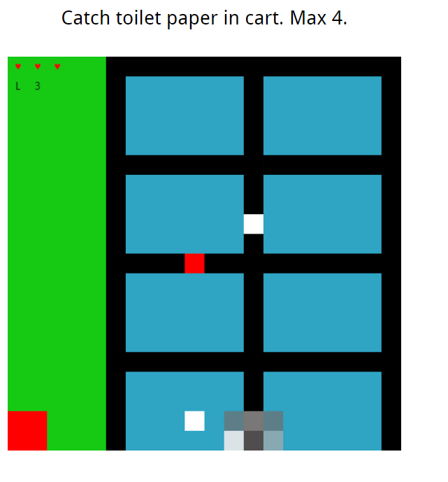
Final Mockup
For the final design I made the background less bright
I added hearts in the corner to indicate lives
I added different levels that progress in difficulty
Each level has a different TP goal
When you reach level three I added corona virus infected TP that makes you take damage

